Slide 1
BT2102
Assignment 1
Group 64
Jacky Ong Kuan Tiam
Lim Zhen Yong Lim Shaun Lii
Lo Zhi Hao

Slide 2
The Final Entities and Attributes:
Members
Books
PublicationYr
ID
Faculty
AccNum
Name
phoneNo
Publisher
Email
Address
Title
isbn
Author1
Author3
Author2

Slide 3
The Final Entities and Attributes:
Fine
Payment
fineID
fineAmt
payID
payNum
payAmt
payDate
Notes:
Focus on entities and Relationship in the assignment.
Or ignore.

Slide 4
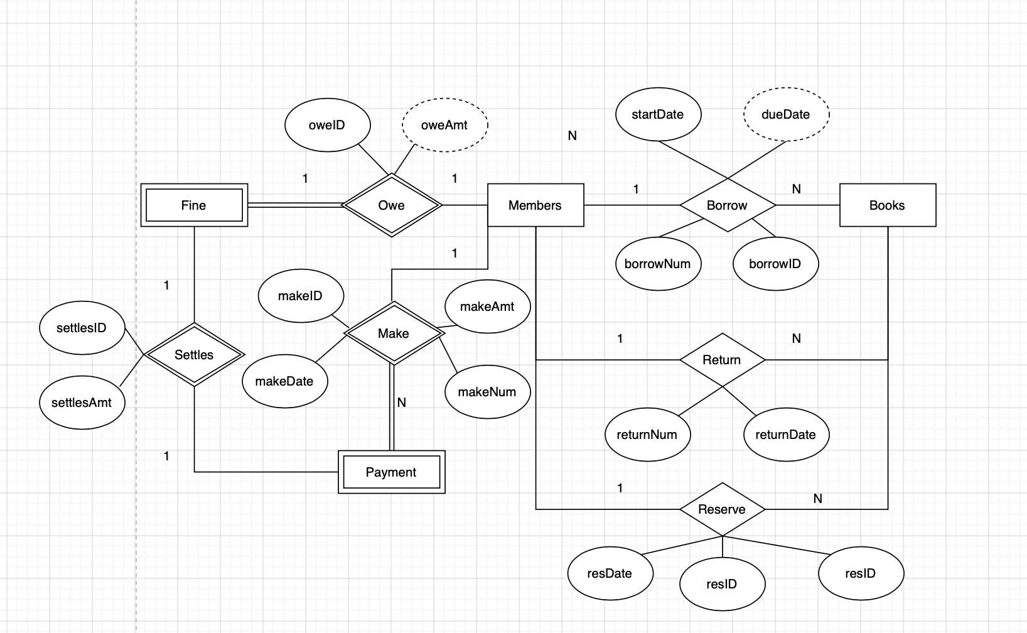
The Final Conceptual Data Model
Notes:
Fine: Payment (1:1 Partial:Total)
Strong/Weak Relationship/Entities
Derived Attribute (Dashed line)

Slide 5
The Final Logical Schema
Entity
Members ( memberID, Name, Faculty, phoneNo, Email)
Books (accNum, title, Author1, Author2, Author3, isbn, Publisher, PublicationYr)
Fine (fineID, fineAmt)
Payment(payNum, payID, payAmt, payDate)
Relationship
Borrow (borrowID, borrowNum, startDate, dueDate)
Return (returnNum, returnDate)
Reserve (resNum, resID, resDate)
Make(makeID, makeNum, makeAmt, makeDate)
Owe (oweID, oweAmt)
Settles ( settlesID, settlesAmt)
Notes:
For weak relationship, should it be included in the final logical schema

Slide 6
The Final Logical Data Model
Members ( memberID, Name, Faculty, phoneNo, Email) Primary Key memberID | BorrowReturn (borrowNum, borrowID, borrowDate, dueDate, returnDate) Foreign Key borrowiD references Members (membersID) Foreign Key borrowNum references Books (accNum)
Books (accNum, title, author1, author2, author3, isbn, Publisher, PublicationYr) Primary Key accNum | SettlePayment (payNum, payID, payAmt, payDate) Primary Key payNum, payID, payDate Foreign Key payID references Members (memberID) Foreign Key payNum references Books (accNum))
Fine (fineID, fineAmt) Foreign Key fineID references Members(memberID) | Reserve (resNum, resID, resDate) Primary Key resNum, resID, resDate Foreign Key resID references Members (memberID) Foreign Key resNum references Books (accNum)
Notes:
Combine relationships and entities

